Slide 1
Multimodal Computational Intelligence for Enhancing Caregiver Performance and Care Delivery
R26-DS-010
Main Supervisor : Prof. Samantha Thelijjagoda
Co – Supervisor : Mr. Samadhi Rathnayake
External Supervisor : Mr. Velu Sivakumar

Slide 2
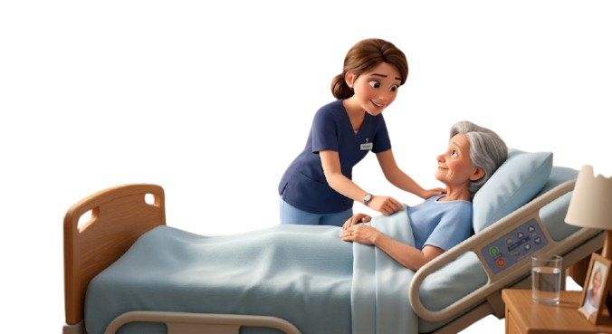
Multimodal Computational Intelligence for Enhancing Caregiver Performance and Care Delivery
1. Real-World Problem
Caregivers face high workload, communication barriers, delayed documentation, and patient fall risks, leading to burnout, lower care quality, and inefficient service delivery.
2. Supporting Evidence
Healthcare studies report that patient falls are a major hospital injury cause, manual documentation consumes caregiver time, and burnout negatively affects workforce performance.
3. Limitations of Existing Solutions
Current systems are mostly isolated and static, with limited integration of workforce analytics, patient monitoring, documentation automation, and communication support.
4. Proposed Solution
A multimodal computational intelligence platform integrating computer vision, speech processing, machine learning, and explainable AI to support caregivers, automate tasks, and improve decision-making.

Slide 3
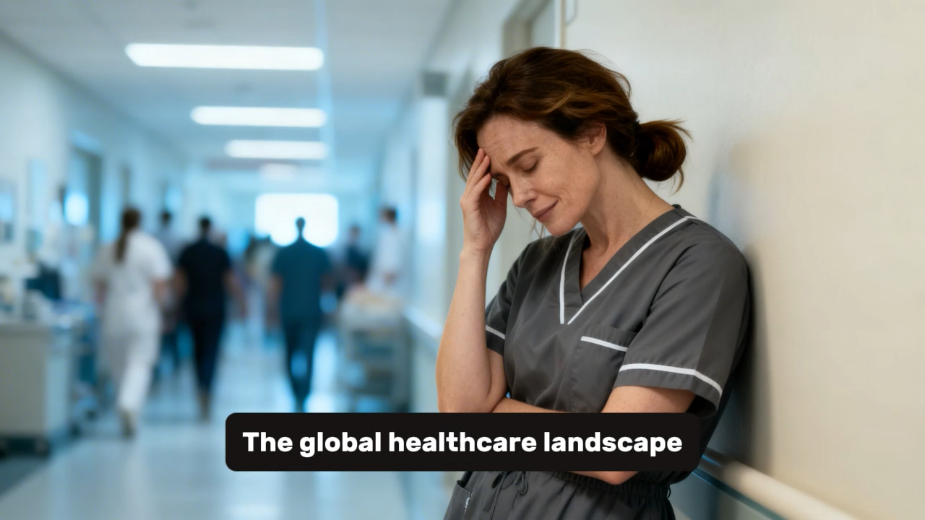

Slide 4
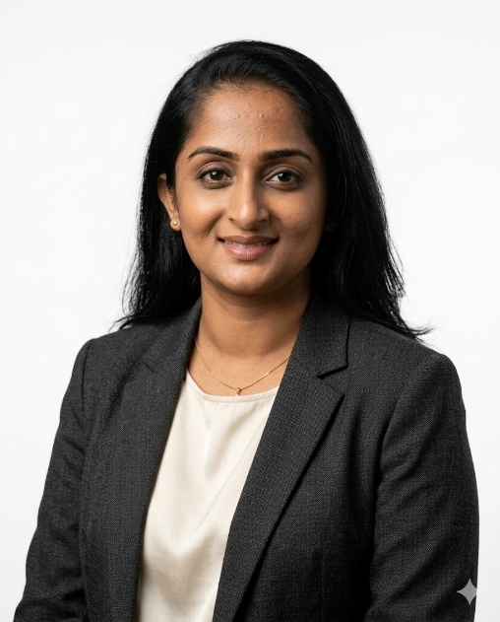
IT22178640 | DAYANA PRIYADHARSHANI KUMAR
Student Must add a professional photo to this cage
Component 01: AI-Assisted Caregiver Workforce Deterioration Detection and Adaptive Workload Redistribution
IT22178640 | DAYANA PRIYADHARSHANI KUMAR | R26-DS-010

Slide 5
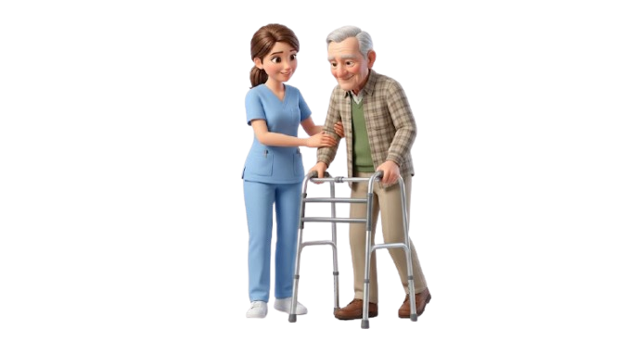
AI-Assisted Caregiver Workforce Deterioration Detection and Adaptive Workload Redistribution
Contribution to the Overall Solution
Workforce layer: Adds workforce intelligence to the overall caregiving solution.
Early detection: Turns schedules, workload, events, and reflections into emerging risk signals.
Cross-component value: Integrates voice-log signals and caregiver activity patterns to better understand workforce deterioration risk
Operational support: Helps supervisors decide when workload should be redistributed, not only observed.
Explainability: Produces case narratives that justify why a caregiver pattern is becoming unsafe.
System impact: Improves caregiver performance continuity, fairness, and care-delivery stability.
IT22178640 | DAYANA PRIYADHARSHANI KUMAR | R26-DS-010

Slide 6
AI-Assisted Caregiver Workforce Deterioration Detection and Adaptive Workload Redistribution
Problem Definition and Novelty
Core problem: Caregiver deterioration develops gradually through unstable schedules, overload, and poor recovery.
Existing
practice
Proposed
module
Existing solutions: Surveys, dashboards, staffing ratios, and generic wellbeing advice are usually static snapshots.
Main gap: They rarely model sequence effects, team structure, or fairness across repeated assignments.
Static snapshot
Trajectory detection
Novelty 1: A dynamic personal baseline learns what is normal for each caregiver before flagging deviation.
Generic advice
Explainable cases
Novelty 2: Temporal risk memory distinguishes one difficult shift from persistent accumulated strain.
Caregiver-only view
Fair redistribution
Novelty 3: Graph-based reasoning supports explainable and fair workload redistribution instead of score-only alerts.
IT22178640 | DAYANA PRIYADHARSHANI KUMAR | R26-DS-010

Slide 7
AI-Assisted Caregiver Workforce Deterioration Detection and Adaptive Workload Redistribution
Main Objective
S
Specific
Design a web-based AI-assisted system to support caregivers
Detect early patterns of workforce deterioration
Enable adaptive workload redistribution using data-driven insights
Utilize behavioral, temporal, and relational data analysis
Evaluate performance using prediction accuracy and decision-support effectiveness
Complete design, development, and evaluation within the project timeline
M
Measurable
A
Achievable
R
Relevant
T
Time-bound
IT22178640 | DAYANA PRIYADHARSHANI KUMAR | R26-DS-010

Slide 8
AI-Assisted Caregiver Workforce Deterioration Detection and Adaptive Workload Redistribution
Sub-Objective - 1: Workload & Behavioral Feature Modeling
Specific: Develop a module to identify and model caregiver workload and behavioral indicators.
Measurable: Compute metrics such as workload index, recovery time, strain levels, and schedule stability.
Achievable: Use available operational and behavioral data to construct feature models.
Relevant: Address key factors contributing to caregiver burnout and workload imbalance.
Time-bound: Complete feature modeling within the system development phase.
S
Specific
M
Measurable
A
Achievable
R
Relevant
T
Time-bound
IT22178640 | DAYANA PRIYADHARSHANI KUMAR | R26-DS-010

Slide 9
AI-Assisted Caregiver Workforce Deterioration Detection and Adaptive Workload Redistribution
Sub-Objective - 2: Personalized Behavioral Profiles
S
Specific
Specific: Build dynamic, individualized behavioral profiles for each caregiver.
Measurable: Evaluate deviation scores between current behavior and baseline patterns.
Achievable: Apply machine learning techniques for adaptive profile generation.
Relevant: Improve detection accuracy by capturing individual variability.
Time-bound: Implement and test during the model training phase.
M
Measurable
A
Achievable
R
Relevant
T
Time-bound
IT22178640 | DAYANA PRIYADHARSHANI KUMAR | R26-DS-010

Slide 10
AI-Assisted Caregiver Workforce Deterioration Detection and Adaptive Workload Redistribution
Sub-Objective - 3: Temporal Pattern & Risk Modeling
Specific: Develop a system to analyze workload trends and model risk accumulation over time.
Measurable: Assess temporal pattern detection accuracy and risk progression trends.
Achievable: Use time-series analysis and sequential data modeling techniques.
Relevant: Overcome limitations of static, snapshot-based analysis methods.
Time-bound: Complete implementation within the modeling and evaluation phase.
S
Specific
M
Measurable
A
Achievable
R
Relevant
T
Time-bound
IT22178640 | DAYANA PRIYADHARSHANI KUMAR | R26-DS-010

Slide 11
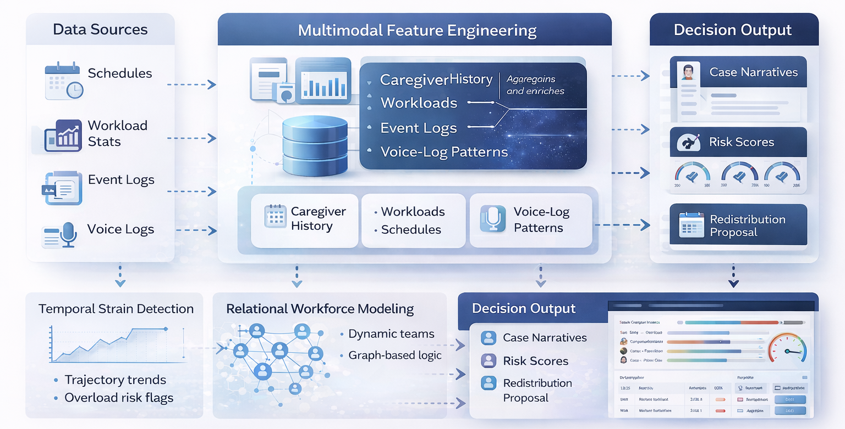
AI-Assisted Caregiver Workforce Deterioration Detection and Adaptive Workload Redistribution
System Overview Diagram
IT22178640 | DAYANA PRIYADHARSHANI KUMAR | R26-DS-010

Slide 12
AI-Assisted Caregiver Workforce Deterioration Detection and Adaptive Workload Redistribution
Domain
knowledge
Multimodal
features
Temporal +
risk memory
Graph +
XAI
Decision
output
Domain knowledge: Caregiver workflow, staffing fairness, patient dependency, recovery gaps, and emergency-heavy contexts.
Methodology base: Multimodal feature engineering from schedules, workload, event logs, and short self-reflections.
Temporal layer: Time-series modeling and accumulation/decay logic capture emerging deterioration trajectories.
Relational layer: Graph modeling represents caregiver–shift–team–ward relationships for structural reasoning.
Latest technologies: Graph ML, sequence learning, explainable AI, and noise-robust learning such as co-teaching.
Delivered output: Soft caregiver insights plus supervisor-facing intervention cases and redistribution options.
IT22178640 | DAYANA PRIYADHARSHANI KUMAR | R26-DS-010

Slide 13
AI-Assisted Caregiver Workforce Deterioration Detection and Adaptive Workload Redistribution
Validation, Data Strategy, and Implementation Details
Validation plan: Compare the proposed model against static scoring, simple workload rules, or non-temporal baselines.
1. Data ingest
Evaluation criteria: Early-risk detection quality, explanation usefulness, fairness, and reassignment feasibility.
Data strategy: Partner data is ideal; public benchmark datasets can validate sub-modules when live data is limited.
2. Personal profile
Security: Use de-identification, role-based access, minimal retention, and protected storage for sensitive records.
3. Temporal + graph reasoning
Implementation flow: Ingest data → build profile → detect risk → explain case → suggest redistribution.
4. Explanation + action
Dependencies: Shared authentication, common data store, and integration points with video, sign-language, and voice-logbook modules.
IT22178640 | DAYANA PRIYADHARSHANI KUMAR | R26-DS-010

Slide 14

IT22057488 | HARISHALINEE ELANGOVAN
Component 02: Edge-Enabled Skeletal Movement Analysis System for Real-Time Patient Fall Prediction
IT22057488 | HARISHALINEE ELANGOVAN | R26-DS-010

Slide 15
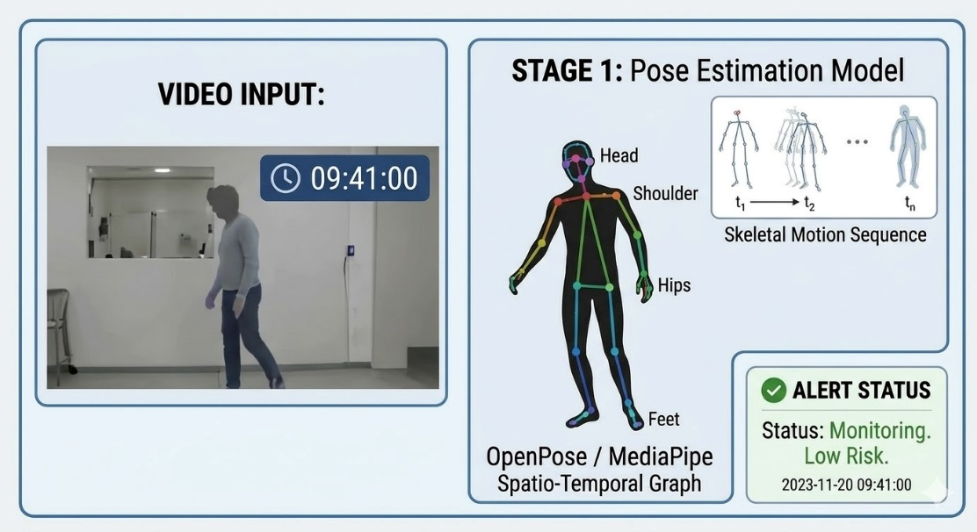
Edge-Enabled Skeletal Movement Analysis System for Real-Time Patient Fall Prediction
Contribution to the Overall Solution
Real-time monitoring: Continuously analyses patient movement using skeletal pose estimation to detect instability in real time.
Privacy-preserving analysis: Converts video into anonymous skeletal joint data and deletes raw footage to ensure patient privacy.
False alarm reduction: Differentiates normal movements from actual fall risk behaviour to minimize unnecessary alerts.
Immediate caregiver alerts: Triggers multi-sensory mobile notifications (audio and vibration) when a high-risk event is predicted.
Explainable event visualization: Provides a 5-second skeletal replay with an instability heatmap to help caregivers understand where the fall risk occurred.
IT22057488 | HARISHALINEE ELANGOVAN | R26-DS-010

Slide 16
Edge-Enabled Skeletal Movement Analysis System for Real-Time Patient Fall Prediction
Problem Definition and Novelty
Core problem: Patient falls in healthcare environments often occur suddenly and without early warning, leading to injuries and delayed caregiver response.
Existing solutions: Traditional monitoring systems detect falls only after they happen or rely on video surveillance that raises privacy concerns.
Main gap: Most systems cannot analyze human movement patterns over time to distinguish normal movement from real fall risk while maintaining patient privacy.
Novelty 1: A privacy-preserving skeletal monitoring approach converts patient video into anonymous joint coordinates while immediately deleting raw footage.
Novelty 2: Edge-based real-time analysis processes patient movement locally without cloud dependency, reducing latency and improving reliability.
Novelty 3: ST-GCN-based motion prediction analyzes skeletal movement patterns to predict potential falls early and trigger caregiver alerts.
IT22057488 | HARISHALINEE ELANGOVAN | R26-DS-010

Slide 17
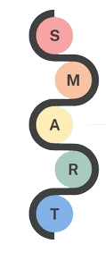
Edge-Enabled Skeletal Movement Analysis System for Real-Time Patient Fall Prediction
Main Objective
Design and develop an edge-enabled skeletal movement analysis system to detect and predict patient falls in real time using pose estimation and deep learning techniques.
Capture patient movement using a camera and extract skeletal joint data for privacy-preserving analysis.
Identify high-risk fall patterns by analyzing spatio-temporal relationships between body joints.
Enable real-time fall prediction and alert generation to support timely caregiver intervention.
Evaluate system performance using accuracy, latency, and false alarm rate metrics.
Complete system design, implementation, and evaluation within the defined project timeline.
IT22057488 | HARISHALINEE ELANGOVAN | R26-DS-010

Slide 18
Edge-Enabled Skeletal Movement Analysis System for Real-Time Patient Fall Prediction
Sub-Objective 1: Skeletal Data Extraction Module
S
Specific: Develop a real-time pose estimation module to extract skeletal joint coordinates from patient video streams using computer vision techniques.
Measurable: Achieve accurate detection of key body joints with real-time processing speed.
Achievable: Utilize existing frameworks such as MediaPipe Pose and optimized image processing pipelines.
Relevant: Enables privacy-preserving monitoring by converting raw video into skeletal representations.
Time-bound: Complete implementation and validation during the initial development phase
IT22057488 | HARISHALINEE ELANGOVAN | R26-DS-010

Slide 19
Edge-Enabled Skeletal Movement Analysis System for Real-Time Patient Fall Prediction
Sub-Objective 2: Fall Prediction Model Development
S
Specific: Develop a deep learning model using ST-GCN to analyze spatio-temporal skeletal data for fall prediction.
Measurable: Achieve high prediction performance with accuracy >90% and reduced false alarm rate.
Achievable: Leverage existing skeleton-based HAR models and publicly available datasets for training and validation.
Relevant: Directly supports accurate identification of high-risk fall events in healthcare environments.
Time-bound: Complete model training, testing, and optimization during the core development phase.
IT22057488 | HARISHALINEE ELANGOVAN | R26-DS-010

Slide 20
Edge-Enabled Skeletal Movement Analysis System for Real-Time Patient Fall Prediction
Sub-Objective 3: Edge-Based Real-Time Alert System
S
Specific: Design and implement a real-time alert system integrated with edge computing to notify caregivers upon detecting fall risks.
Measurable: Ensure system latency is below 1–2 seconds for real-time response and alert delivery.
Achievable: Deploy the system on local devices (e.g., laptops or edge nodes) without reliance on cloud infrastructure.
Relevant: Improves response time and enhances patient safety in critical situations.
Time-bound: Complete system integration, testing, and deployment before final evaluation phase.
IT22057488 | HARISHALINEE ELANGOVAN | R26-DS-010

Slide 21
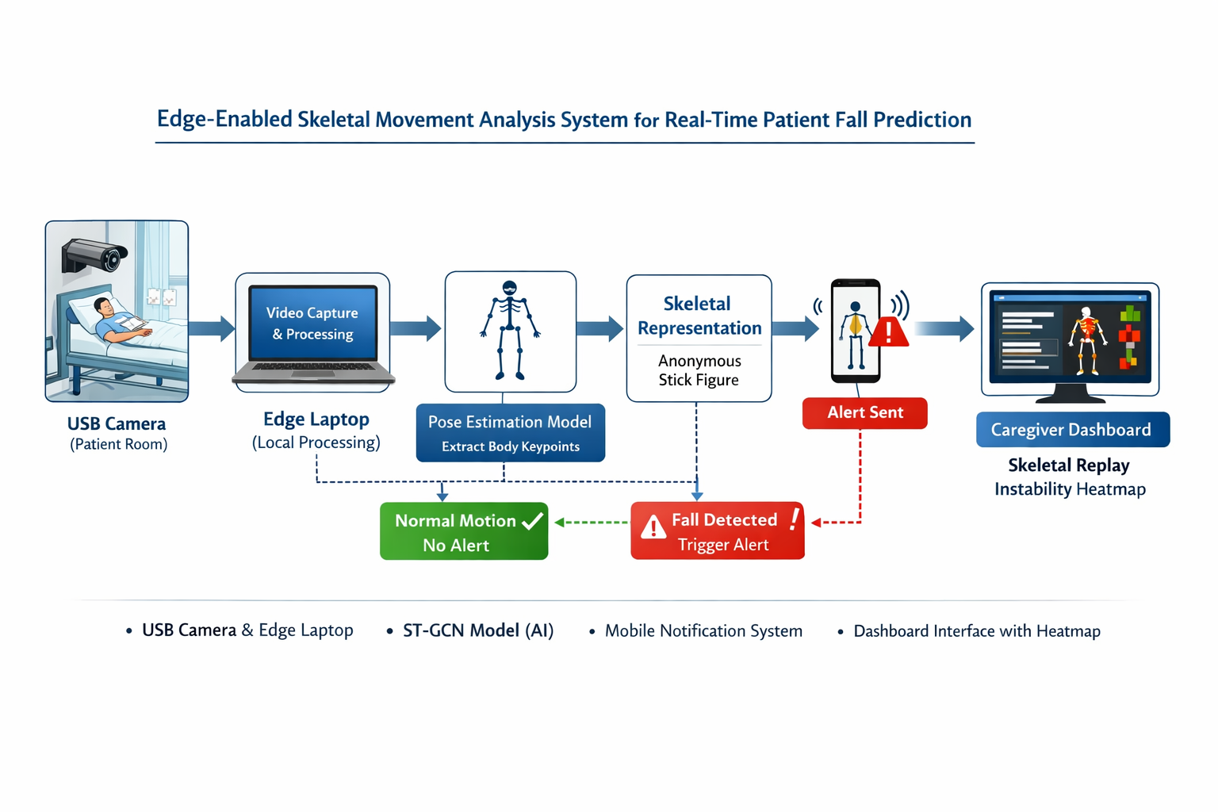
Edge-Enabled Skeletal Movement Analysis System for Real-Time Patient Fall Prediction
IT22057488 | HARISHALINEE ELANGOVAN | R26-DS-010

Slide 22
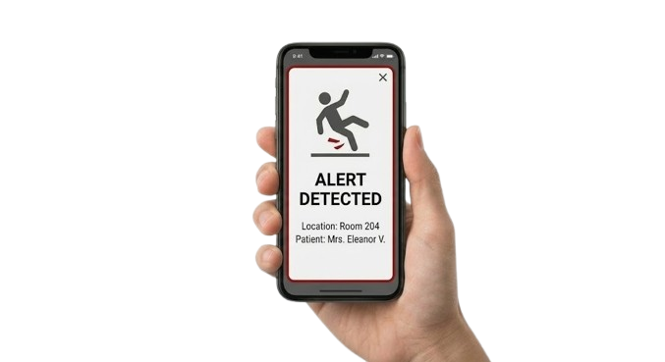
Edge-Enabled Skeletal Movement Analysis System for Real-Time Patient Fall Prediction
Application of Domain Knowledge and Methodology
Domain knowledge: Human movement analysis, patient safety monitoring, fall risk patterns, and healthcare environment constraints.
Methodology base: Skeletal pose extraction from video and feature generation from body joint coordinates.
Temporal layer: Spatio-temporal motion modeling analyzes joint movement sequences to detect instability patterns.
Relational layer: Skeletal graph representation models body joints and their relationships for motion understanding.
Latest technologies: Pose estimation models, ST-GCN (Spatio-Temporal Graph Convolutional Networks), edge computing, and real-time computer vision.
Delivered output: Real-time fall risk prediction, caregiver alerts, and privacy-safe skeletal event visualization with instability heatmap.
IT22057488 | HARISHALINEE ELANGOVAN | R26-DS-010

Slide 23
Edge-Enabled Skeletal Movement Analysis System for Real-Time Patient Fall Prediction
Validation, Data Strategy, and Implementation Details
Validation plan: Evaluate the proposed model against traditional fall detection approaches and simple motion-threshold methods.
Evaluation criteria: Fall prediction accuracy, false alarm rate, detection latency, and reliability of caregiver alerts.
Data strategy: Public human pose datasets and simulated movement scenarios are used for model validation when real patient data is limited.
Security: Ensure privacy by converting video into skeletal joint data and immediately deleting raw footage after pose extraction.
Implementation flow: Capture video → extract skeletal pose → analyze motion using ST-GCN → predict fall risk → trigger caregiver alert and visualization.
Dependencies: USB camera, edge laptop, pose estimation model, ST-GCN model, mobile notification service, and caregiver dashboard.
IT22057488 | HARISHALINEE ELANGOVAN | R26-DS-010

Slide 24

IT22294098 | VIDURSHA PRABAGARAN
Component 03: Context-Aware Intelligent System for Automated ADL Extraction and Real-Time Documentation from Caregiver Voice Logs
IT22294098 | VIDURSHA PRABAGARAN | R26-DS-010

Slide 25
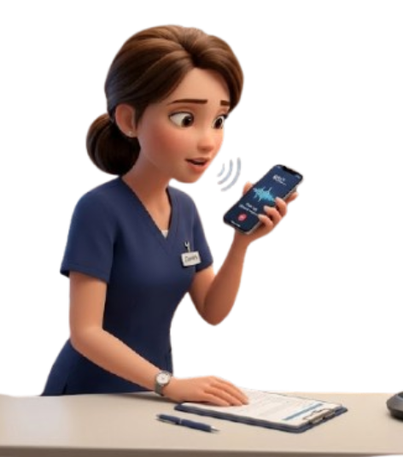
Context - Aware Intelligent System For Automated ADL Extraction And Real Time Documentation From Caregiver Voice Logs
Problem Definition:
Manual documentation takes time and can be delayed, incomplete, or inaccurate.
This increases caregiver workload and may reduce patient safety and care quality.
The system converts caregiver speech into clear and structured ADL records in real time
Novelty:
Speech recognition
Wake-word based ambient scribing and voice shortcuts
Auto-editing
ADL extraction
Intelligent reporting
Shift handover
3D spoken summaries
IT22294098 | VIDURSHA PRABAGARAN | R26-DS-010

Slide 26
Context-Aware Intelligent System for Automated ADL Extraction and Real-Time Documentation from Caregiver Voice Logs
Main Objective
S
Specific
Design a context-aware intelligent system for ADL documentation from caregiver voice logs.
Convert caregiver speech into structured ADL records automatically.
Apply auto-editing to remove fillers, hesitations, and spoken corrections.
Improve accuracy and completeness of care documentation.
Generate shift handover summaries in text, speech, and 3D avatar video form.
Enhance continuity of care and patient safety through timely and clear information.
M
Measurable
A
Achievable
R
Relevant
T
Time-bound
IT22294098 | VIDURSHA PRABAGARAN | R26-DS-010

Slide 27
Context-Aware Intelligent System for Automated ADL Extraction and Real-Time Documentation from Caregiver Voice Logs
Sub-Objective - 1 : Voice Capture and Auto-Editing
S
Specific
Specific: Develop a module to capture caregiver voice logs and automatically remove fillers, hesitations, and spoken corrections.
Measurable: Measure performance using speech recognition accuracy and disfluency detection results.
Achievable: Can be implemented using existing ASR and disfluency handling techniques such as Whisper and NLP-based auto-editing.
Relevant: Directly supports the need to reduce documentation burden and improve spoken input quality.
Time-bound: This component will be designed, developed, and tested within the planned research development period.
M
Measurable
A
Achievable
R
Relevant
T
Time-bound
IT22294098 | VIDURSHA PRABAGARAN | R26-DS-010

Slide 28
Context-Aware Intelligent System for Automated ADL Extraction and Real-Time Documentation from Caregiver Voice Logs
Sub-Objective - 2 : ADL Extraction and Context-Aware Structuring
Specific: Develop a domain-specific NLP module to extract ADL-related information such as medication, food intake, mobility, hygiene, symptoms, and emotional observations.
Measurable: Measure extraction performance using precision, recall, and F1-score.
Achievable: Can be developed using named entity recognition, text classification, and context-aware processing methods.
Relevant: This component is essential for transforming raw caregiver speech into structured care documentation.
Time-bound: This module will be completed and evaluated during the system implementation and testing stages.
S
Specific
M
Measurable
A
Achievable
R
Relevant
T
Time-bound
IT22294098 | VIDURSHA PRABAGARAN | R26-DS-010

Slide 29
Context-Aware Intelligent System for Automated ADL Extraction and Real-Time Documentation from Caregiver Voice Logs
Sub-Objective - 3: Intelligent Reporting and Shift Handover Support
S
Specific
Specific: Generate structured ADL reports and shift handover summaries in text, speech, and 3D avatar video form.
Measurable: Evaluate the summaries based on clarity, completeness, correctness, and usefulness.
Achievable: Can be implemented by integrating reporting, Text-to-Speech, and 3D avatar presentation technologies.
Relevant: Supports continuity of care and improves communication between outgoing and incoming caregivers.
Time-bound: This feature will be developed in the final stage of the project and validated before the final presentation.
M
Measurable
A
Achievable
R
Relevant
T
Time-bound
IT22294098 | VIDURSHA PRABAGARAN | R26-DS-010

Slide 30
Context - Aware Intelligent System For Automated ADL Extraction And Real Time Documentation From Caregiver Voice Logs
Application of Domain Knowledge: The proposed system uses healthcare knowledge related to Activities of Daily Living such as medication, meals, mobility, hygiene, sleep, and emotional condition.
Research Methodology: The study follows requirement analysis, speech processing, natural language processing, system design, implementation, and testing.
Knowledge Domain that Contributes to the Methodology: The methodology is supported by healthcare knowledge, speech recognition, natural language processing, and intelligent system design.
Latest Technologies Used: Whisper for speech-to-text, spaCy for NLP, NLTK for text preprocessing, Transformers from Hugging Face for context-aware summarization, Porcupine for wake-word detection, and pyttsx3 for text-to-speech.
Validation and Evaluation: The system can be evaluated using transcription accuracy, ADL extraction accuracy, usability testing, and the quality of generated reports and shift handover summaries.
Data Availability, Security, and Ethical Clearance: The system requires caregiver voice data and ADL-related information, while ensuring patient privacy, secure data handling, and proper ethical approval before using real healthcare data.
IT22294098 | VIDURSHA PRABAGARAN | R26-DS-010

Slide 31
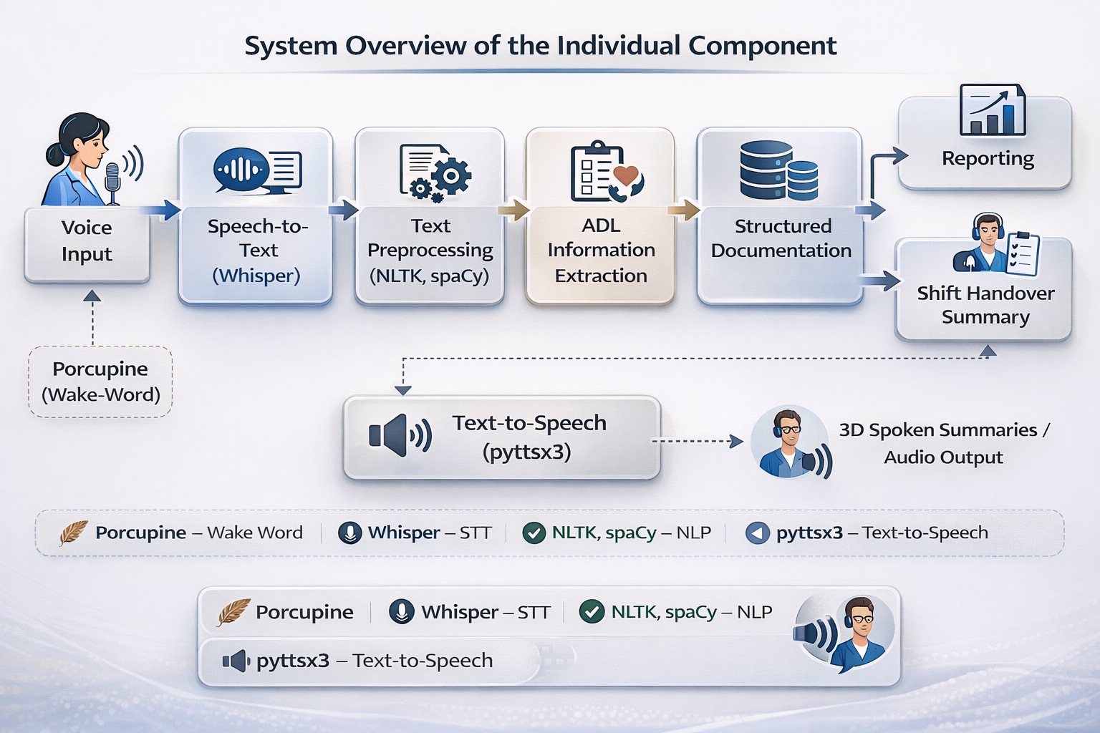
Context – Aware Intelligent System For Automated ADL Extraction And Real Time Documentation From Caregiver Voice Logs
System overview
IT22294098 | VIDURSHA PRABAGARAN | R26-DS-010
IT22294098 | Vidursha Prabagaran | R26-DS-010

Slide 32
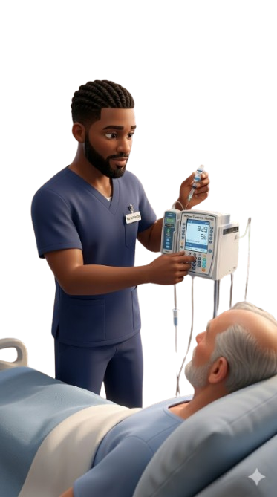
Context – Aware Intelligent System For Automated ADL Extraction And Real Time Documentation From Caregiver Voice Logs
Validation, Data Strategy, and Implementation Details
Validation: The proposed solution will be evaluated based on speech transcription accuracy, ADL information extraction accuracy, and the quality of the generated reports and shift handover summaries.
Usability Testing: The system will also be tested to measure how easy, useful, and practical it is for caregivers in real care environments.
Data Strategy: The research will use caregiver voice samples and ADL-related text data for system training, testing, and performance evaluation.
Data Security and Ethics: All data will be managed securely by anonymizing patient information, maintaining confidentiality, limiting access to authorized users, and following ethical guidelines during data collection and system use.
IT22294098 | VIDURSHA PRABAGARAN | R26-DS-010

Slide 33

IT22289384 | KAUSHALYA NAGENTHRARAJA
Component 04: Personalized Sign Language Tutoring System for Caregivers
IT22289384 | KAUSHALYA NAGENTHRARAJA | R26-DS-010

Slide 34
Personalized Sign Language Tutoring System for Caregivers
Problem Definition:
Caregivers struggle to communicate effectively with deaf or hard-of-hearing care recipients during everyday care delivery.
Current sign-learning systems are largely generic and do not adequately support caregiver-specific, guided, and adaptive learning.
This creates a clear need for a personalized tutoring system that improves practical and confidence-building care communication.
Novelty
Caregiver-specific sign tutoring for real care-delivery communication, instead of general sign-language learning
Adaptive and explainable learning support through speed-tolerant evaluation and corrective feedback, not just sign recognition
Integrated tutoring approach combining vision-based assessment, 3D avatar guidance, and personalized practice within the overall Caregiver Co-Pilot solution
IT22289384 | KAUSHALYA NAGENTHRARAJA | R26-DS-010

Slide 35
PERSONALIZED SIGN LANGUAGE TUTORING SYSTEM FOR CAREGIVERS
Main Objective
S
Specific
Define and identify care-related signs and phrases required for routine caregiving communication
Develop a computer vision-based system to evaluate caregiver-performed signs with measurable accuracy and timing tolerance
Design interpretable feedback and 3D avatar guidance for correcting hand movement and timing errors
Implement adaptive learning to personalize practice based on user performance and repeated errors1
Evaluate system usability and learning effectiveness through user testing within the project timeline.
M
Measurable
A
Achievable
R
Relevant
T
Time-bound
IT22289384| Kaushalya Nagenthraraja | R26-DS-010

Slide 36
PERSONALIZED SIGN LANGUAGE TUTORING SYSTEM FOR CAREGIVERS
Sub-Objective 1: Care-Related Sign Identification and Definition
Specific: Develop a structured set of essential care-related sign language gestures and phrases required for routine caregiving communication scenarios..
Measurable: Evaluate completeness by compiling a validated set of approximately 20–50 key signs and ensuring coverage of common caregiving tasks.
Achievable: Can be implemented using literature review, expert consultation, and analysis of real-world caregiving communication needs.
Relevant: This component is essential for ensuring that the tutoring system focuses on practical, caregiver-specific communication rather than general vocabulary.
Time-bound: This module will be completed during the initial phase of the project before system design and development.
S
Specific
M
Measurable
A
Achievable
R
Relevant
T
Time-bound
IT22289384 | Kaushalya Nagenthraraja | R26-DS-010

Slide 37
PERSONALIZED SIGN LANGUAGE TUTORING SYSTEM FOR CAREGIVERS
Sub-Objective - 2 :Gesture Capture and Evaluation Module
Specific: Develop a computer vision-based module to capture caregiver-performed sign gestures and evaluate them using hand landmark detection and motion analysis
Measurable: Measure performance using gesture evaluation accuracy, timing tolerance, and consistency of landmark detection across multiple attempts..
Achievable: Can be implemented using existing frameworks such as MediaPipe for hand tracking and Dynamic Time Warping (DTW) for sequence comparison.
Relevant: This component is critical for enabling real-time assessment of caregiver-performed signs and forming the foundation for feedback generation.
Time-bound: This module will be completed and evaluated during the system implementation and testing stages.
S
Specific
M
Measurable
A
Achievable
R
Relevant
T
Time-bound
IT22289384 | Kaushalya Nagenthraraja | R26-DS-010

Slide 38
PERSONALIZED SIGN LANGUAGE TUTORING SYSTEM FOR CAREGIVERS
Sub-Objective - 3 : Interpretable Feedback and 3D Avatar Guidance
Specific: Develop a feedback module that generates interpretable corrective guidance and provides real-time 3D avatar demonstrations to assist users in correcting hand movement and timing errors.
Measurable: Evaluate effectiveness based on clarity of feedback, reduction in repeated errors, and improvement in user performance over successive practice attempts.
Achievable: Can be implemented using rule-based feedback mechanisms combined with 3D visualization tools such as Three.js for avatar-based guidance.
Relevant:This component is essential for transforming gesture evaluation results into actionable learning support, improving user understanding and skill acquisition.
Time-bound: This component is essential for transforming gesture evaluation results into actionable learning support, improving user understanding and skill acquisition.
S
Specific
M
Measurable
A
Achievable
R
Relevant
T
Time-bound
IT22289384 | Kaushalya Nagenthraraja | R26-DS-010

Slide 39
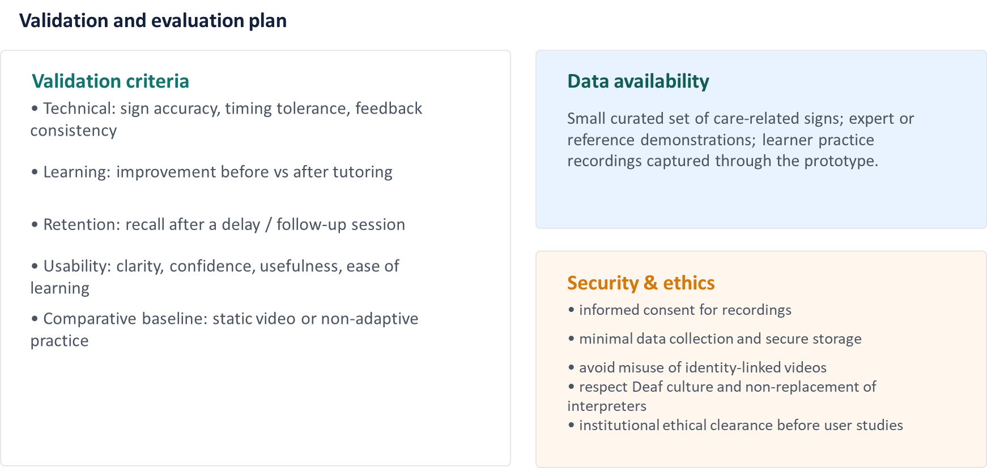
Personalized Sign Language Tutoring System for Caregivers
IT22289384 | Kaushalya N | R26-DS-010
IT22289384 | KAUSHALYA NAGENTHRARAJA | R26-DS-010

Slide 40
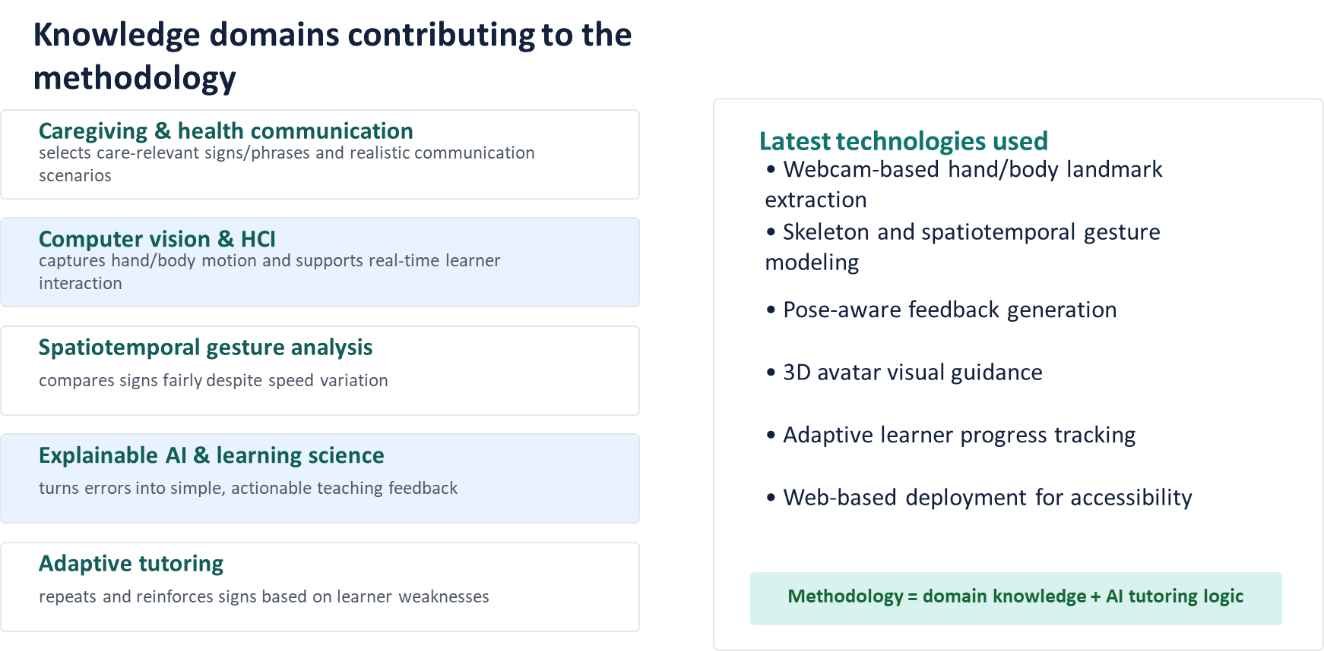
Personalized Sign Language Tutoring System for Caregivers
IT22289384 | Kaushalya N | R26-DS-010
IT22289384 | KAUSHALYA NAGENTHRARAJA | R26-DS-010

Slide 41
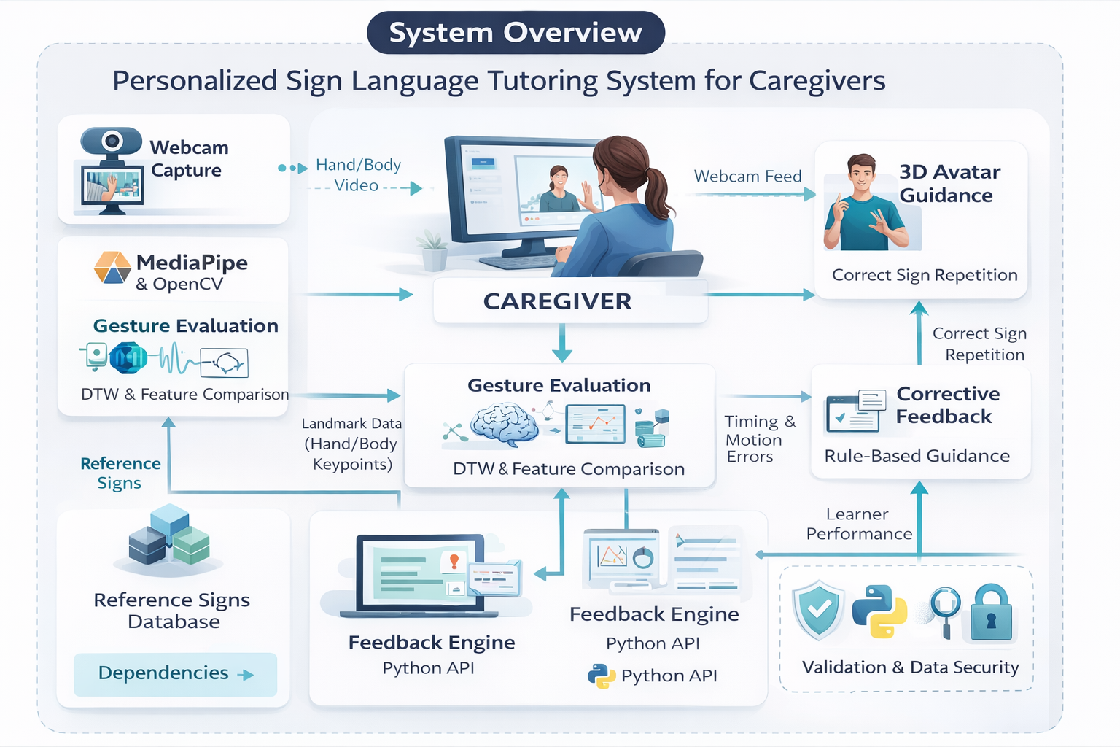
Personalized Sign Language Tutoring System for Caregivers
IT22289384 | Kaushalya N | R26-DS-010
IT22289384 | KAUSHALYA NAGENTHRARAJA | R26-DS-010

Slide 42
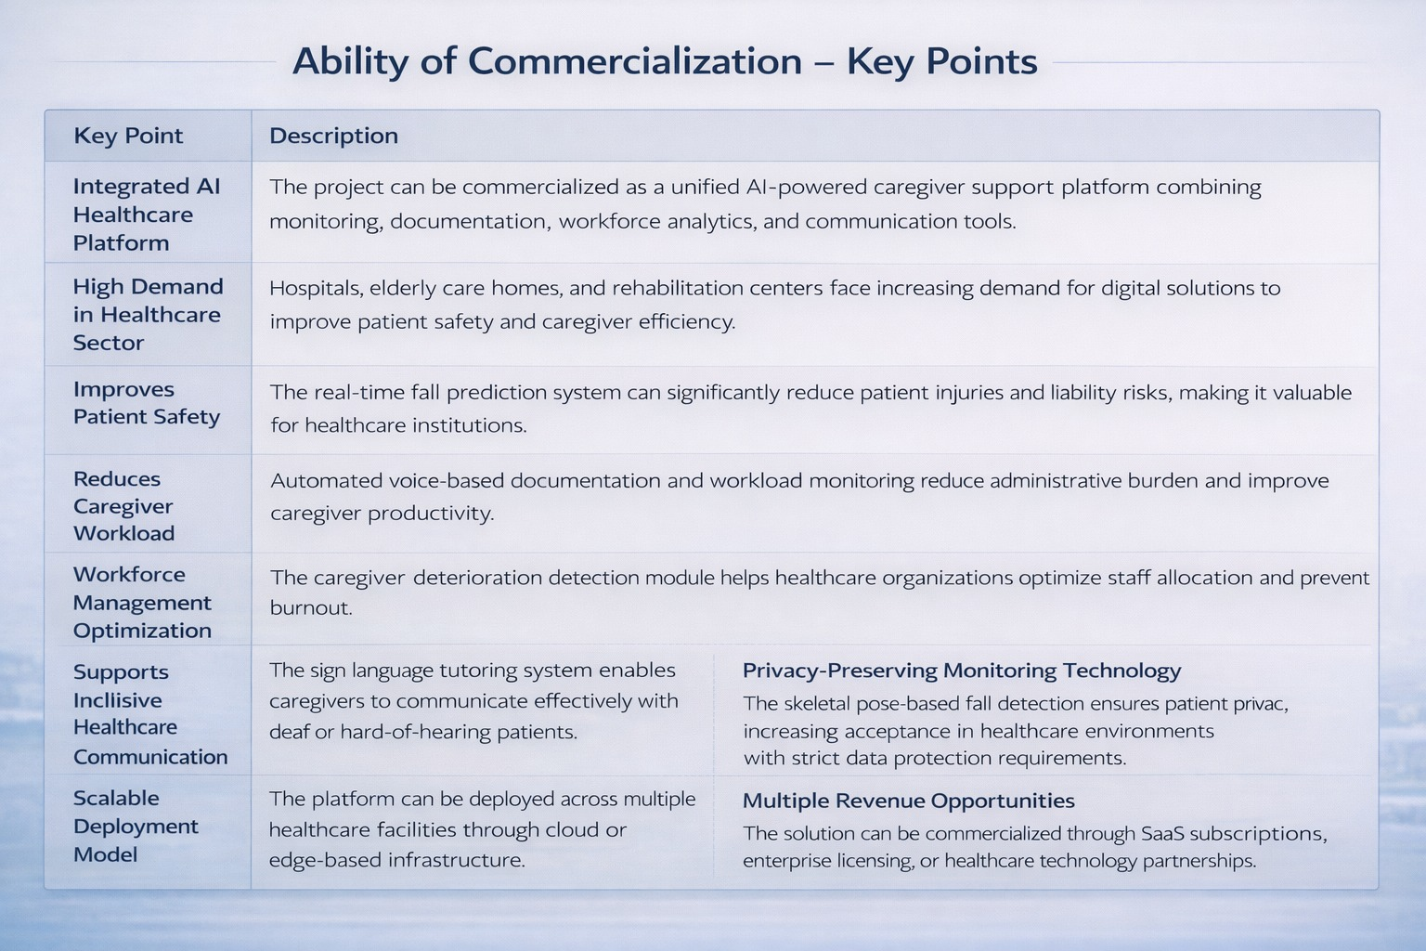
Multimodal Computational Intelligence for Enhancing Caregiver Performance and Care Delivery

Slide 43
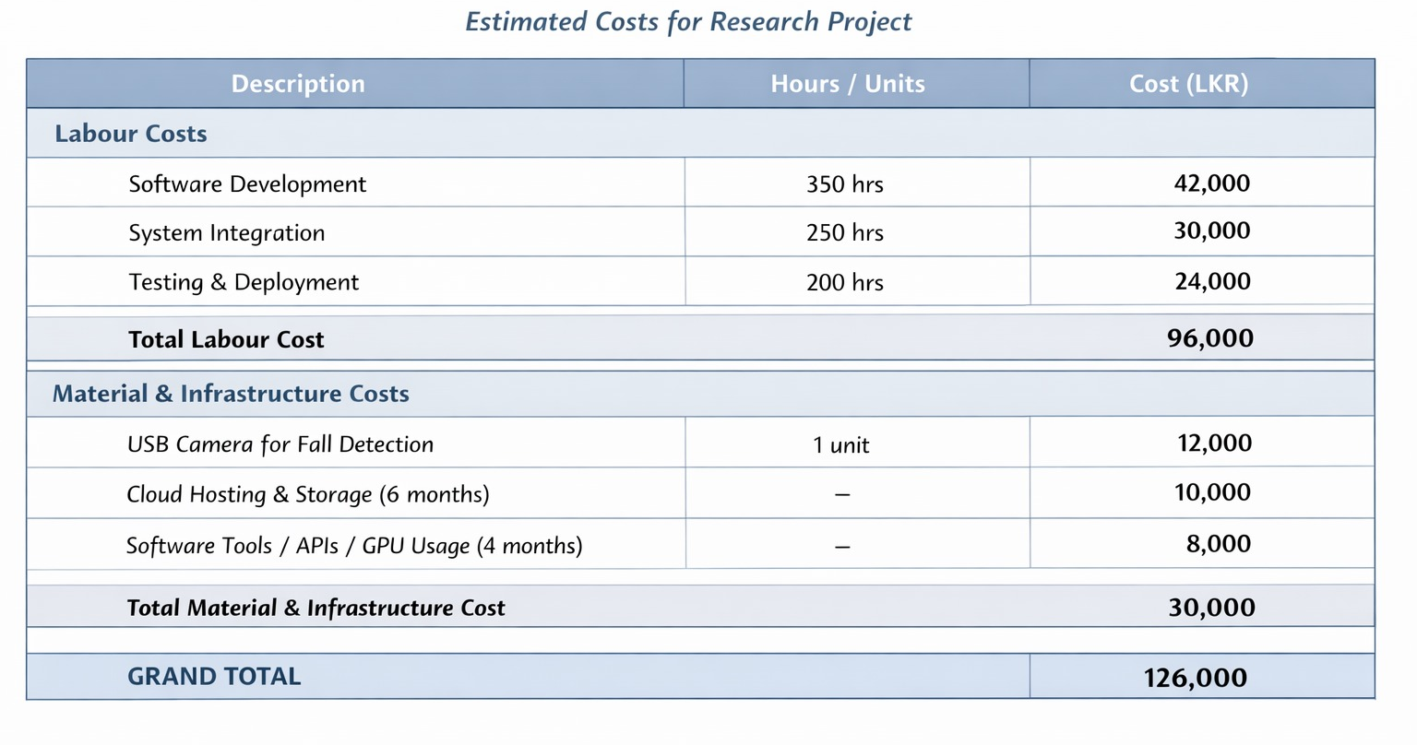
Multimodal Computational Intelligence for Enhancing Caregiver Performance and Care Delivery

Slide 44
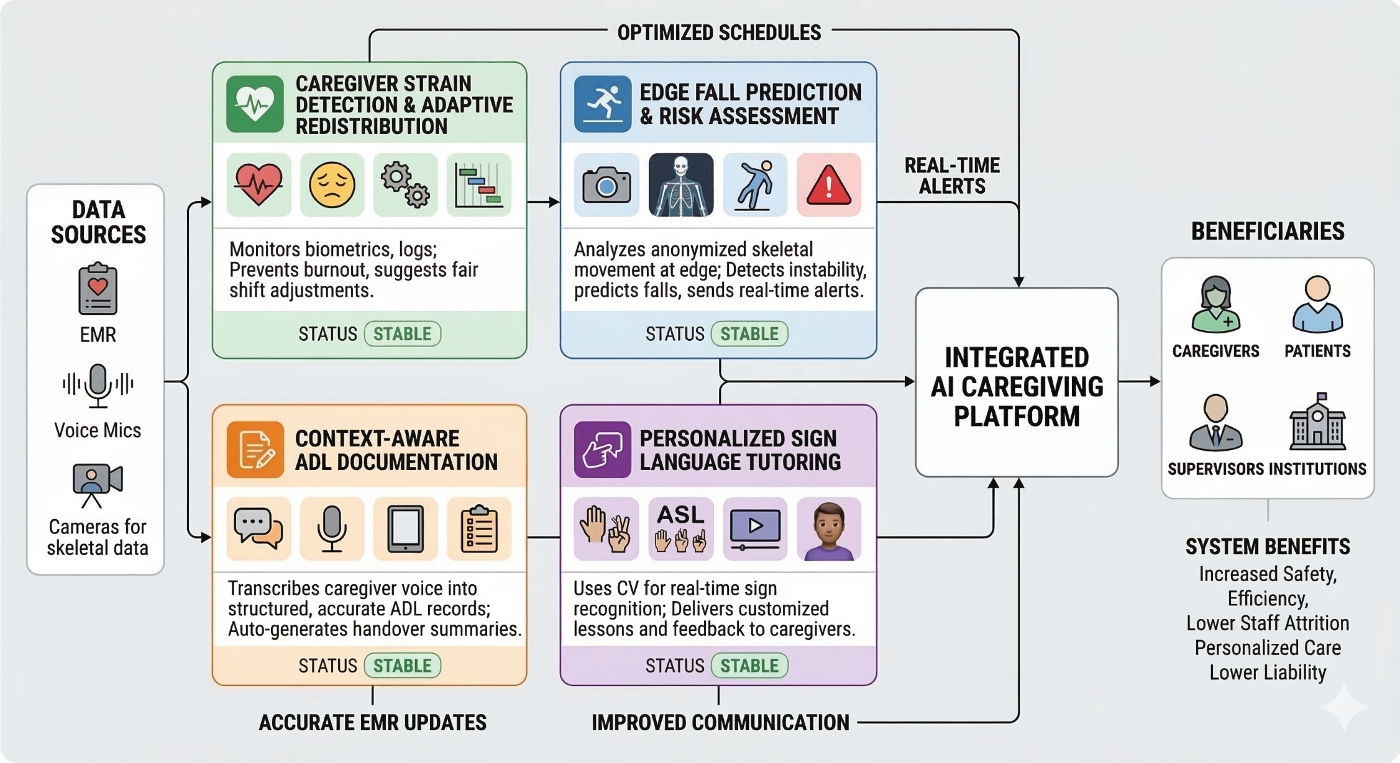
Multimodal Computational Intelligence for Enhancing Caregiver Performance and Care Delivery – System Overview Diagram

Slide 45
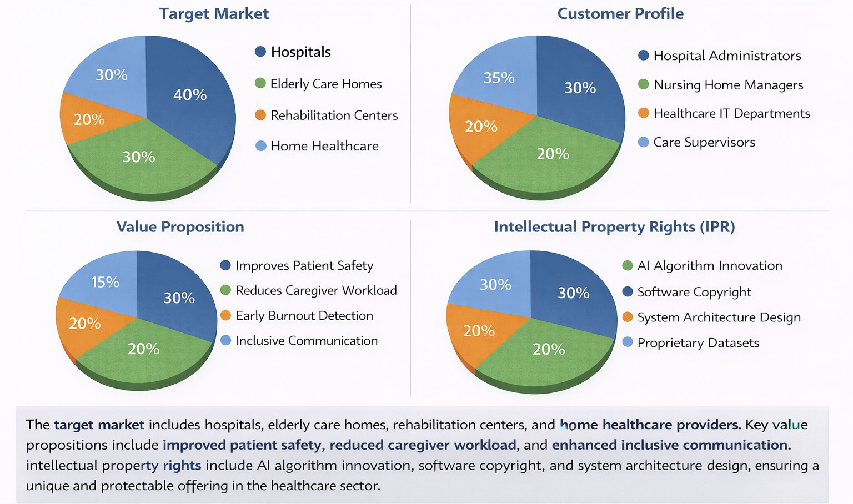
Multimodal Computational Intelligence for Enhancing Caregiver Performance and Care Delivery

Slide 46
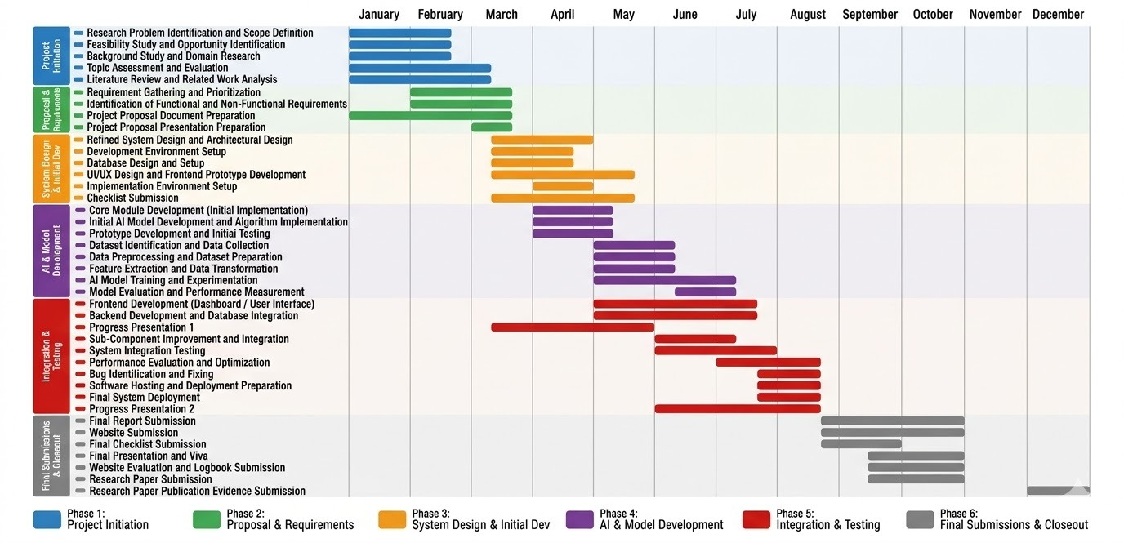
Multimodal Computational Intelligence for Enhancing Caregiver Performance and Care Delivery – Gantt Chart

Slide 47
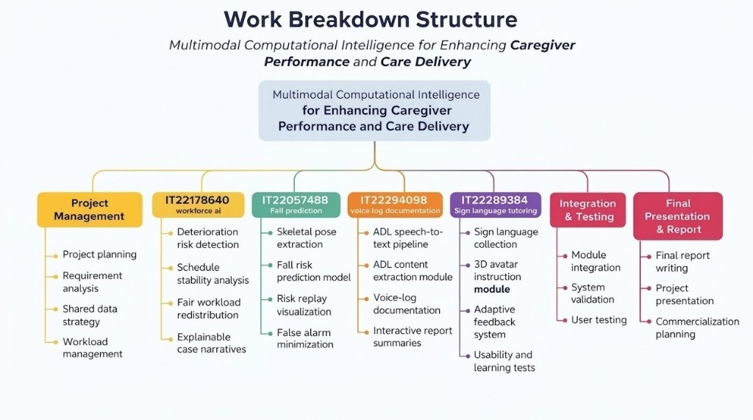

Slide 48


Slide 49


